Slide 1
USA Presidents
By Kate Hill In Galileo class

Slide 2
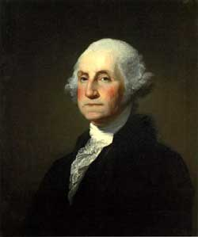
George Washington
Born: February 22 1732
Born Place : Pope’s Creek Virginia
1 American president for 8 years
He had 3 brothers 2 sisters
Died age : 62 years old
Died : December 14 1799

Slide 3
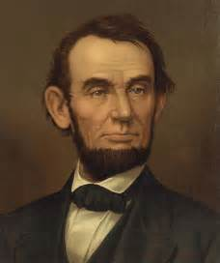
Abraham Lincoln
Born : February 12 1809
Born Place : Sinking Spring in the south of Hodgenville
16 president for 4 years
He had 1 sister
Died age : 56 years old
Died : April 15 1865 assassinated

Slide 4
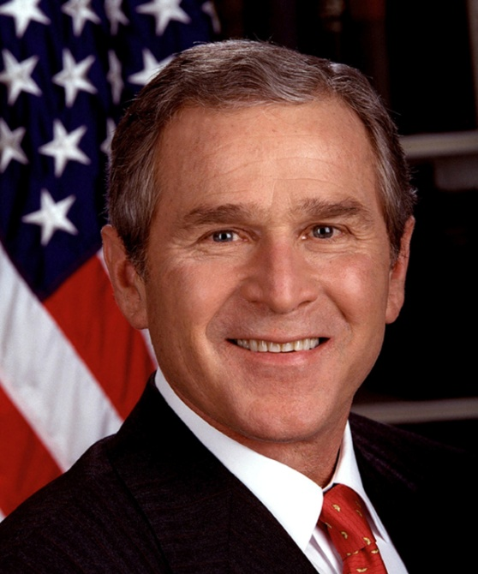
George W Bush
Born : 6 July 1946
Born Place : New Haven CT
43 president for 7 years and when I was born
He has 3 brothers 2 sisters
Died age : Still alive
Died : Still alive

Slide 5
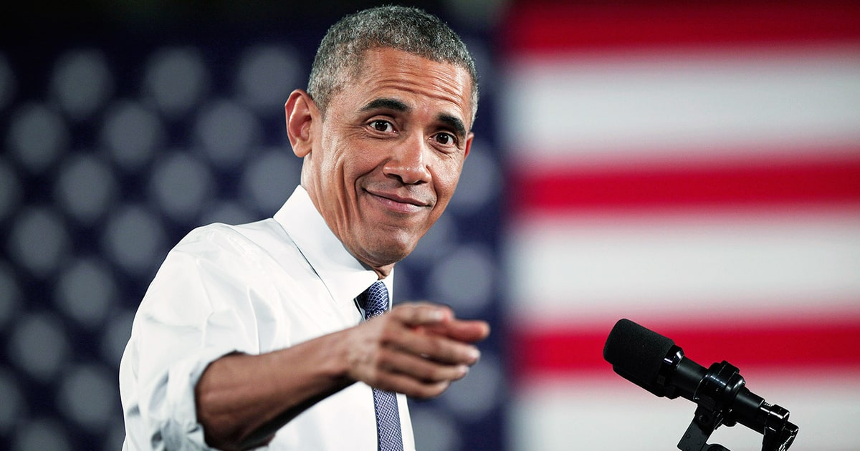
Barack Obama
Born : August 4 1961
Born Place : Honolulu Hawaii
44 president for 8 years
He has 6 brothers and 2 sisters
Died age : Still alive
Died : Still alive

Slide 6
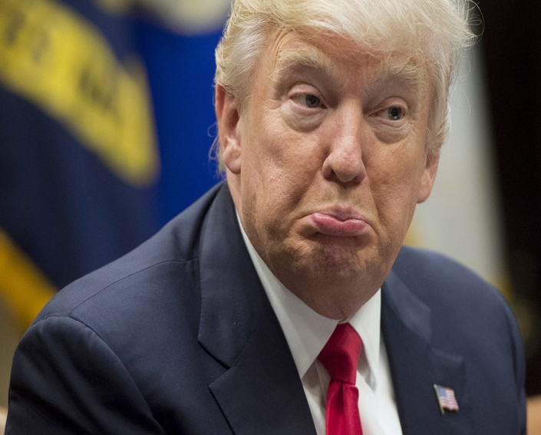
Donald Trump
Born : June 14 1946
Born place :Queens in New York City
45 president and is president now
He has 2 brother 2 sisters
Died age : Still alive
Died : Still alive
Thank You for reading

